Slide 1

Show, Attend and Tell: Neural Image Caption Generation with Visual Attention
$αβnormal$ Distri$β$ution
AC295/CS115
Notes:
Welcome to the talk on ”Show, Attend and Tell: A Neural Image Caption Generation Algorithm with Visual Attention" by Abnormal Distribution!

Slide 2
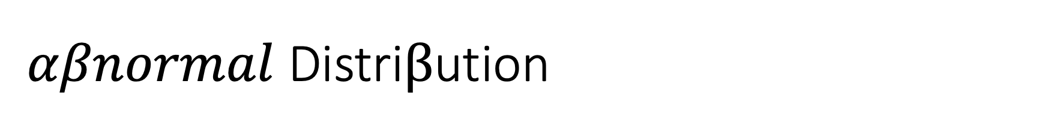
$αβnormal$ Distri$β$ution
Eduardo Peynetti
Jessica Wijaya
Rohit Beri
Stuart Neilson
Notes:
This is us, Eduardo, Jessica, Rohit, and Stuart

Slide 3
Contents
Show, Attend & Tell
Transformers
Q&A
Ed Questions

Slide 4
Show, Attend and Tell
Neural Image Caption Generation with Visual Attention

Slide 5
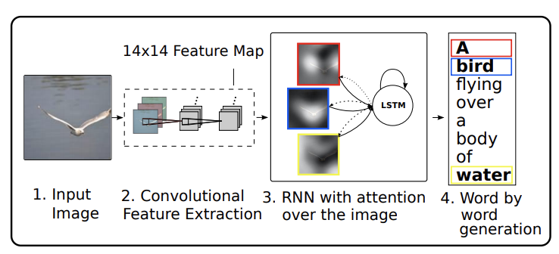
Show, Attend and Tell
Attention-based Model
Automatically learns to describe the content of the images
Two ways to train the model
State-of-the-art performance on three different datasets

Slide 6
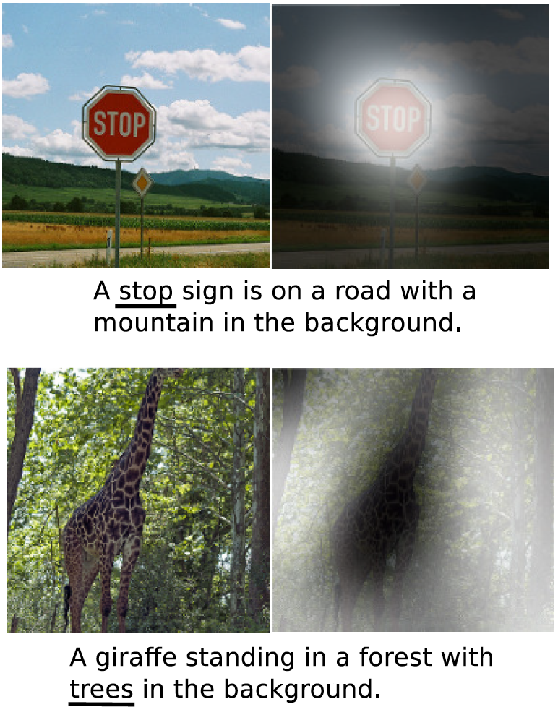
Automatic Caption Generation
At the heart of scene understanding
One of the primary goals of computer vision
Express relationships of objects in a natural language
Mimicking human ability to compress visual information into descriptive language

Slide 7
Attention
One of the most curious facets of human visual system
Allows for salient features to dynamically come to the forefront as needed
Particularly important when there is lot of clutter
Top-layer representations distill information to most salient objects
Loss of information required for richer and more descriptive captions
Low-level representations can help preserve this information
Two attention-based image caption generators
Soft deterministic attention
Hard stochastic attention

Slide 8
Timeline – Image Captioning/Visual Attention
2011
2014
2016
2020
Generating caption templates which were filled in based on the results of object detections and attribute discovery
First retrieving similar captioned images for a large dataset and then modifying these retrieved captions to fit the query
2012
Flurry of Neural Networks based approaches
Show, Attend and Tell
An Image is worth 16 x 16 words
FFNN, RNN, LSTM & R-CNN based approaches
Transformer based architecture for image recognition
Neural image caption generation with visual attention

Slide 9
Image Caption Generation – Model Overview

Slide 10



Encoder – Oxford VGG

Slide 11
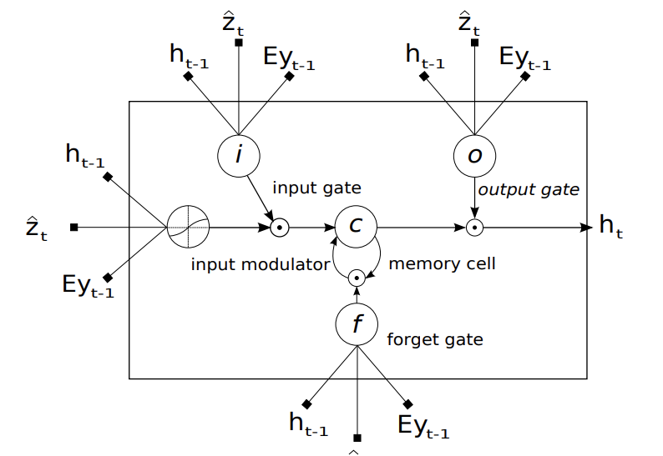
Decoder – LSTM with Attention

Slide 12
Decoder – LSTM with Attention
LSTM generates one word at every time step, conditioned on:​
Context vector z_{t}
Previous hidden state h_{t-1}
Previously generated word y_{t-1​}
LSTM
$$\left(\begin{matrix}\begin{matrix}i_{t} \\ f_{t}\end{matrix} \\ \begin{matrix}o_{t} \\ g_{t}\end{matrix}\end{matrix}\right)= \left(\begin{matrix}\begin{matrix}σ \\ σ\end{matrix} \\ \begin{matrix}σ \\ tanh\end{matrix}\end{matrix}\right)T_{D+m+n, n}\left(\begin{matrix}{Ey}_{t−1} \\ h_{t−1} \\ {\hat{z}}_{t}\end{matrix}\right)$$
(■8(■8(𝑖_𝑡@𝑓_𝑡 )@■8(𝑜_𝑡@𝑔_𝑡 )))= (■8(■8(𝜎@𝜎)@■8(𝜎@𝑡𝑎𝑛ℎ))) 𝑇_(𝐷+𝑚+𝑛, 𝑛) (■8(〖𝐸𝑦〗_(𝑡−1)@ℎ_(𝑡−1)@𝑧 ̂_𝑡 ))
$$c_{t}= f_{t}⊙c_{t−1}+ i_{t}⊙g_{t}$$
𝑐_𝑡= 𝑓_𝑡⊙𝑐_(𝑡−1)+ 𝑖_𝑡⊙𝑔_𝑡
$$h_{t}= o_{t}⊙{tanh⁡(c}_{t−1})$$
ℎ_𝑡= 𝑜_𝑡⊙〖tanh⁡(𝑐〗_(𝑡−1))
Notes:
where:
it = input state
gt = input modulator
ft = forget state
ct = memory
ot = output
ht = hidden state
zt ∈ RD = context vector, to capture the visual information associated with a particular input location
E ∈ Rm × K = embedding matrix of dimension m x K
σ and
⨀ be the logistic sigmoid activation & element-wise multiplication respectively

Slide 13
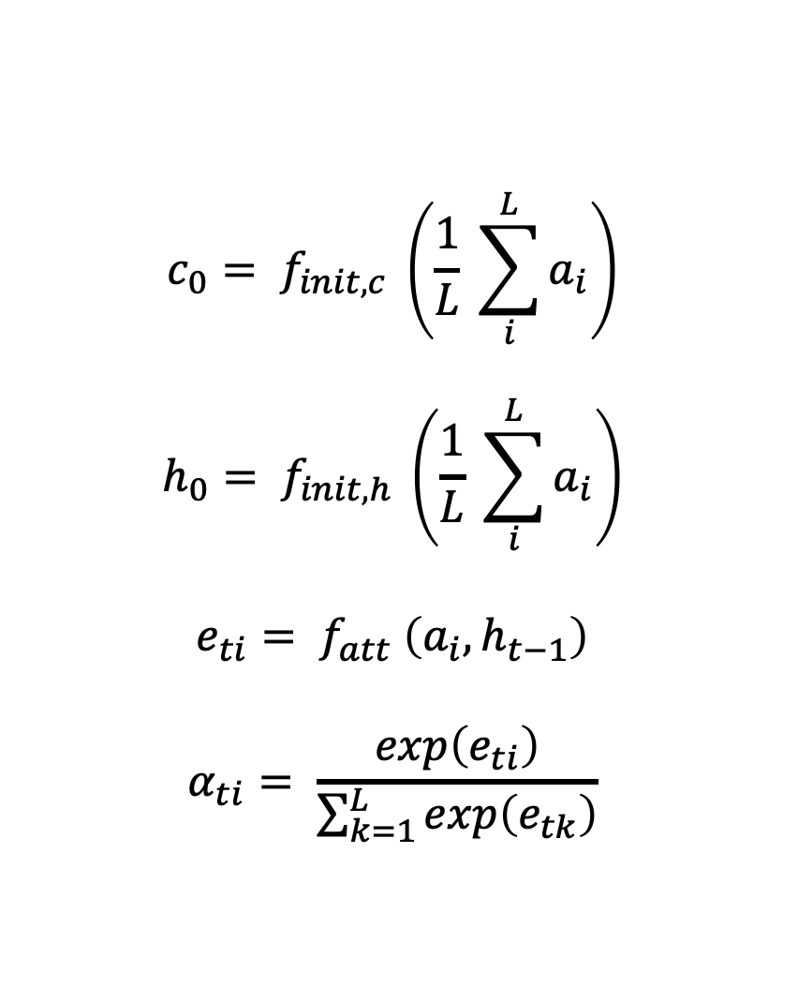
Decoder – LSTM with Attention
Initial Memory State and Hidden State
Average of the Annotation Vectors
Weight α_{i} of each Annotation Vector a_{i}
Computed by the attention model f_{att}
MLP conditioned on the h_{t−1}.
$$c_{0}= f_{init, c} \left(\frac{1}{L} \sum_{i}^{L}{a_{i}}\right)$$
$$h_{0}= f_{init, h} \left(\frac{1}{L} \sum_{i}^{L}{a_{i}}\right)$$
$$e_{ti}= f_{att} \left(a_{i}, h_{t−1}\right)$$
$$α_{ti}= \frac{exp\left(e_{ti}\right)}{\sum_{k=1}^{L}{exp\left(e_{tk}\right)}}$$

Slide 14
Decoder – LSTM with Attention
Context Vector: $\hat{z_{t}}$
Context Vector: (𝑧_𝑡 ) ̂
Mechanism: $φ$
Mechanism: 𝜙
Deep output layer
Dynamic representation of the relevant part of the image at time t
Probability: Hard attention
$p\left(y_{t} | a, y_{1}^{t−1}\right)∝ e^{(L_{0}(Ey_{t−1}+ L_{h}h_{t}+ L_{z}\hat{z_{t}}))}$
𝒑(𝒚_𝒕│𝒂, 𝒚_𝟏^(𝒕−𝟏) )∝ 𝒆^((𝑳_𝟎 (𝑬𝒚_(𝒕−𝟏)+ 𝑳_𝒉 𝒉_𝒕+ 𝑳_𝒛 (𝒛_𝒕 ) ̂)))
$$\hat{z_{t}}= φ\left(\left\{a_{i}\right\} , \left\{α_{i}\right\}\right)$$
(𝒛_𝒕 ) ̂= 𝝓({𝒂_𝒊 } , {𝜶_𝒊 })
Relative Importance: Soft attention
Probability of the output word
Meaning of $α_{i}$
Meaning of 𝛼_𝑖
Where: $L_{0}∈ℝ^{K × m}, L_{h}∈ℝ^{m × n}, L_{z}∈ℝ^{m × D},$ and $E$ are learned parameters
Where: 𝐿_0∈ℝ^(𝐾 × 𝑚), 𝐿_ℎ∈ℝ^(𝑚 × 𝑛), 𝐿_𝑧∈ℝ^(𝑚 × 𝐷), and 𝐸 are learned parameters
Notes:
Algorithm:
Mechanism φ will compute z_{t} from the annotation vectors a_{i} :
In hard attention: α_{i} = prob. that location i is the right place to focus for producing the next word
In soft attention: α_{i} = relative importance to give to location i in blending the α_{i}’s together.
z_{t} => dynamic rep. of the relevant part of the image at time t (contect vector)
h_{t} (hidden state) => varies as the output RNN advances in its output sequence
Deep output layer => compute the output word probability y_{t} (given h_{t}, z_{t}, y_{t-1})

Slide 15
Show, Attend & Tell – Architecture
Encoder - Oxford VGG
Decoder
Attention
LSTM
Prediction
Caption
Conv2D: 5 Layers
MaxPooling: 4 Layers

Slide 16
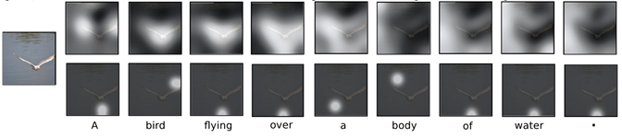
Soft vs Hard Attention
Hard Attention
Soft Attention
Differentiable and amenable to standard backpropagation
$φ$ returns a_{i} at every time step using multinouilli distribution sampling
𝝓 returns a_{i} at every time step using multinouilli distribution sampling
$φ$ returns the expectation of the context vector
𝝓 returns the expectation of the context vector
Monte-Carlo based sampling to compute the gradient

Slide 17
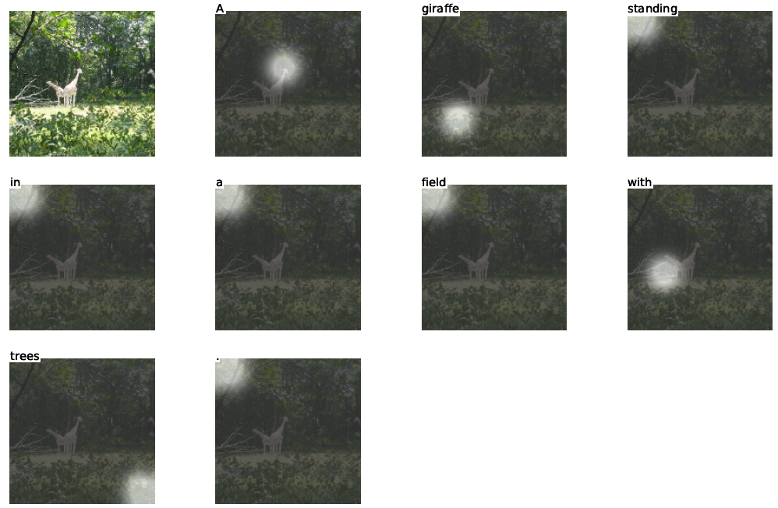
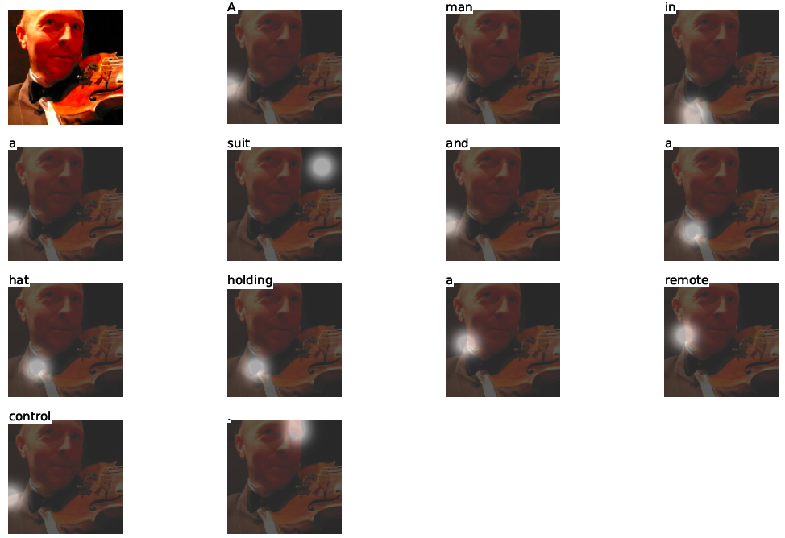
Hard (Stochastic) Attention
Correct Captioning
Incorrect Captioning

Slide 18
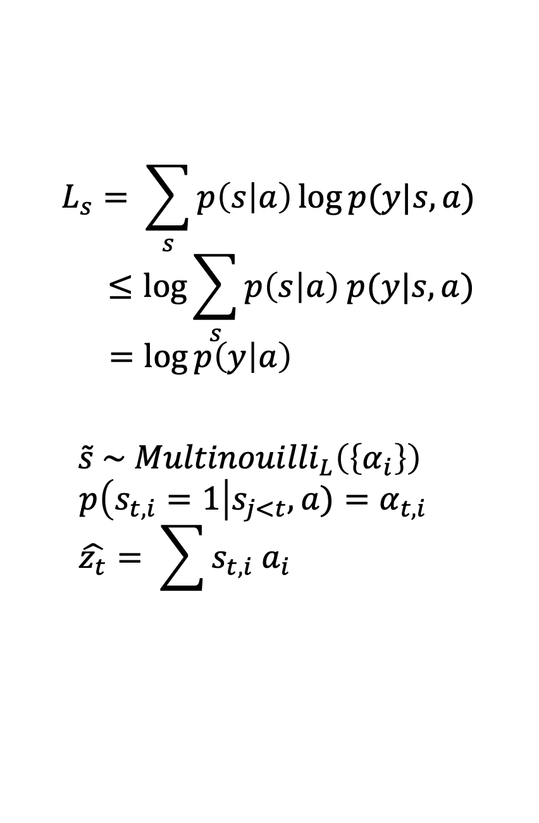
Hard (Stochastic) Attention
Objective function: L_{s}
$$\log{p(y|a)}$$
log⁡〖𝑝(𝑦|𝑎)〗
Hard to compute
Location where the model focuses on when generating the t^{th} word
Latent Variable: s_{t}
Likelihood of observing words y given image feature a
Optimize the variational lower bound instead
$$L_{s}= \sum_{s}{p\left(s | a\right)\log{p(y|s,a)}}$$
$$≤\log{\sum_{s}{p\left(s | a\right) p(y|s,a)}}$$
$$=\log{p\left(y | a\right) }$$
$$\tilde{s} \sim {Multinouilli}_{L}\left(\left\{α_{i}\right\}\right)$$
$$p\left(s_{t, i}=1\right|s_{j<t}, a)=α_{t, i}$$
$$\hat{z_{t}}= \sum{s_{t, i} a_{i}}$$

Slide 19
Hard (Stochastic) Attention
Optimize L_{s}
Function not differentiable
Sampling Based Approximation
Variance Reduction & Regularization
Final Learning Rule – REINFORCE Learning
$$L_{s}=\log{p\left(y | a\right) }$$
𝑳_𝒔=𝐥𝐨𝐠⁡〖𝒑(𝒚│𝒂) 〗
$$\frac{∂L_{s}}{∂W}= \sum_{s}{p(s|a)\left[\frac{∂\log{p(y|s,a)}}{∂W}+\log{p(y|s,a)} \frac{∂\log{p(s|a)}}{∂W}\right]}$$
(𝝏𝑳_𝒔)/𝝏𝑾= ∑8_𝒔▒〖𝒑(𝒔|𝒂)[(𝝏 𝐥𝐨𝐠⁡〖𝒑(𝒚|𝒔,𝒂)〗)/𝝏𝑾+𝐥𝐨𝐠⁡〖𝒑(𝒚|𝒔,𝒂)〗 (𝝏 𝐥𝐨𝐠⁡〖𝒑(𝒔|𝒂)〗)/𝝏𝑾] 〗
$$\frac{∂L_{s}}{∂W}≈ \frac{1}{N}\sum_{n=1}^{N}{\left[\frac{∂\log{p(y|{\tilde{s}}^{n},a)}}{∂W}+\log{p(y|{\tilde{s}}^{n},a)} \frac{∂\log{p({\tilde{s}}^{n}|a)}}{∂W}\right]}$$
(𝝏𝑳_𝒔)/𝝏𝑾≈ 𝟏/𝑵 ∑24_(𝒏=𝟏)^𝑵▒[(𝝏 𝐥𝐨𝐠⁡〖𝒑(𝒚|𝒔 ̃^𝒏,𝒂)〗)/𝝏𝑾+𝐥𝐨𝐠⁡〖𝒑(𝒚|𝒔 ̃^𝒏,𝒂)〗 (𝝏 𝐥𝐨𝐠⁡〖𝒑(𝒔 ̃^𝒏 |𝒂)〗)/𝝏𝑾]
Use a moving average baseline
$$\frac{∂L_{s}}{∂W}≈ \frac{1}{N}\sum_{n=1}^{N}{\left[\frac{∂\log{p(y|{\tilde{s}}^{n},a)}}{∂W}+λ_{r}(\log{p\left(y | {\tilde{s}}^{n},a\right)−b)} \frac{∂\log{p\left({\tilde{s}}^{n} | a\right)}}{∂W}+ λ_{e}\frac{∂H[{\tilde{s}}^{n}]}{∂W}\right]}$$
(𝝏𝑳_𝒔)/𝝏𝑾≈ 𝟏/𝑵 ∑_(𝒏=𝟏)^𝑵▒[(𝝏 𝐥𝐨𝐠⁡〖𝒑(𝒚|𝒔 ̃^𝒏,𝒂)〗)/𝝏𝑾+𝝀_𝒓 (𝐥𝐨𝐠⁡〖𝒑(𝒚│𝒔 ̃^𝒏,𝒂)−𝒃)〗 (𝝏 𝐥𝐨𝐠⁡〖𝒑(𝒔 ̃^𝒏│𝒂)〗)/𝝏𝑾+ 𝝀_𝒆 (𝝏𝑯[𝒔 ̃^𝒏])/𝝏𝑾]
Add an entropy term H[s]

Slide 20
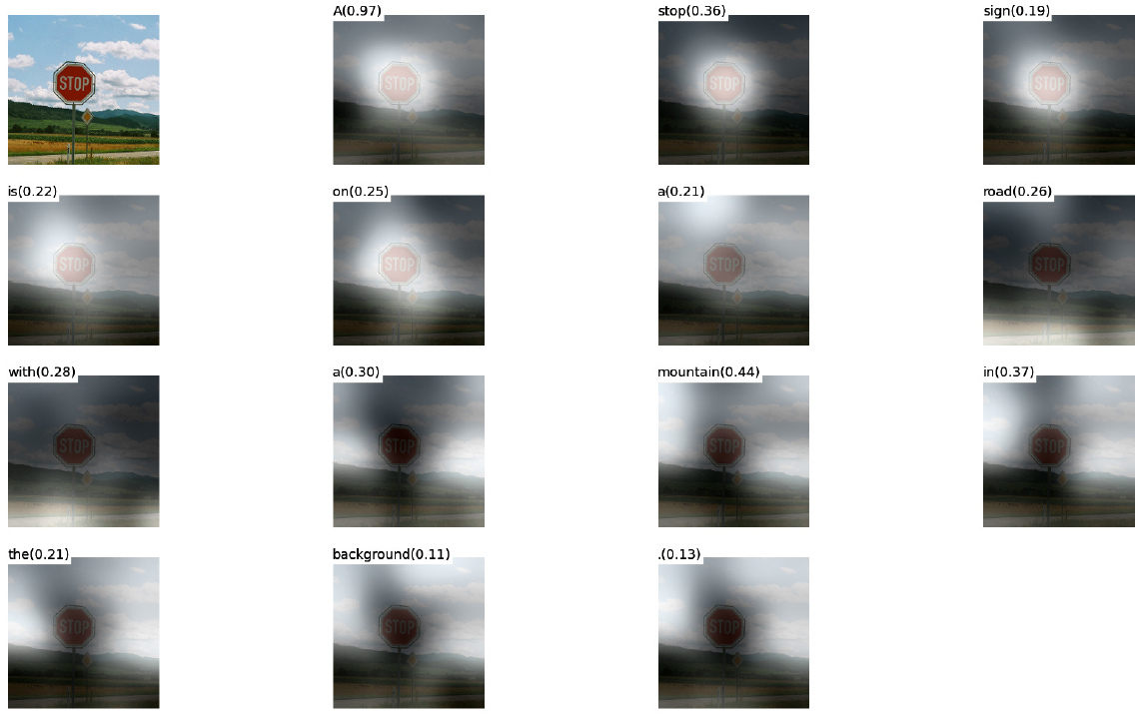
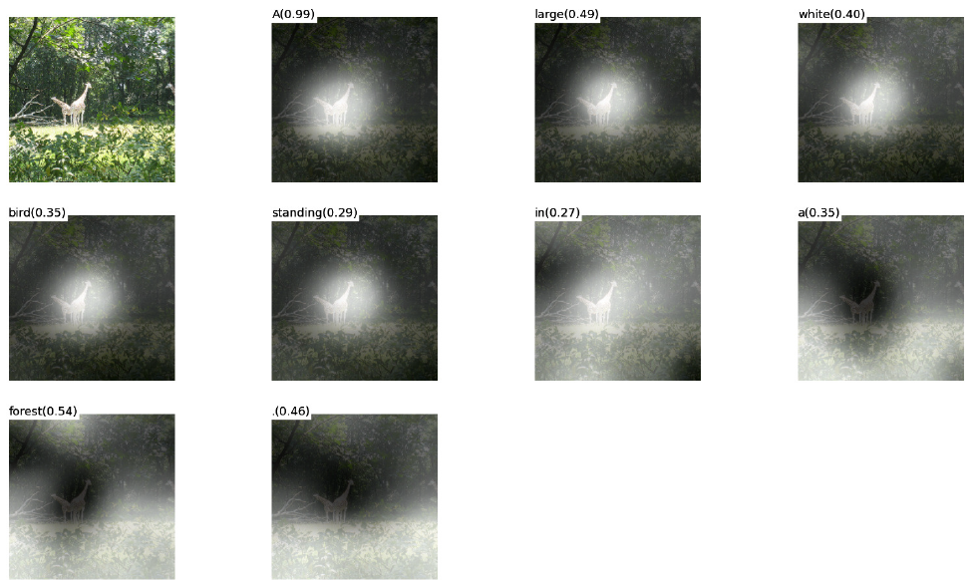
Soft (Deterministic) Attention
Correct Captioning
Incorrect Captioning

Slide 21
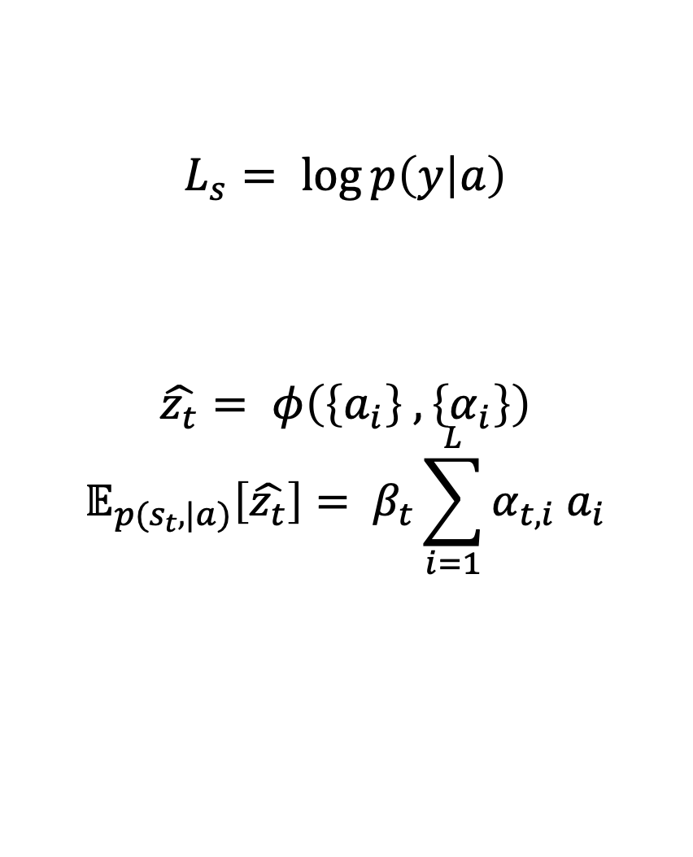
Soft (Deterministic) Attention
Objective function: L_{s}
$$\log{p(y|a)}$$
log⁡〖𝑝(𝑦|𝑎)〗
Model is differentiable and amenable to backpropagation
Directly computes the expectation of the context vector
Context Vector: $\hat{z_{t}}$
Context Vector: (𝑧_𝑡 ) ̂
Likelihood of observing words y given image feature a
$$L_{s}= \log{p\left(y | a\right)}$$
$$\hat{z_{t}}= φ\left(\left\{a_{i}\right\} , \left\{α_{i}\right\}\right)$$
$$𝔼_{p(s_{t},|a)}\left[\hat{z_{t}}\right]= β_{t}\sum_{i=1}^{L}{α_{t, i} a_{i}}$$

Slide 22
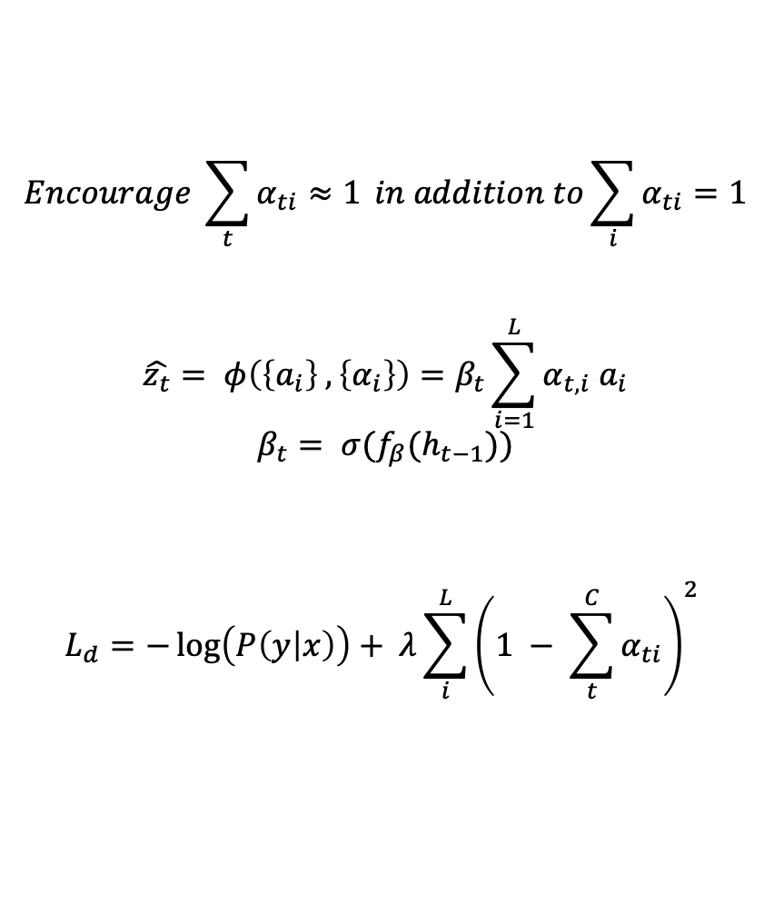
Soft (Deterministic) Attention
Doubly Stochastic Regularization
Forces algorithm to pay equal attention to every part of the image over the course of caption generation
Predicted from previous hidden state h_{t-1} at each time-step t
Model also predicts 𝛽
Minimize penalized negative log-likelihood
Final Objective Function
$$Encourage \sum_{t}{α_{ti}≈1} in addition to\sum_{i}{α_{ti}=1}$$
$$\hat{z_{t}}= φ\left(\left\{a_{i}\right\} , \left\{α_{i}\right\}\right)=β_{t}\sum_{i=1}^{L}{α_{t, i} a_{i}}$$
$$β_{t}= σ(f_{β}(h_{t−1}))$$
$$L_{d}=−\log\left(P\left(y | x\right)\right)+ λ\sum_{i}^{L}{{\left(1 − \sum_{t}^{C}{α_{ti}}\right)}^{2}}$$

Slide 23
Datasets
Flickr8k
Flickr30k
Microsoft COCO
8,000 images
5 reference sentences per image
30,000 images
5 reference sentences per image
82,783 images
Some images have >5 reference sentences

Slide 24
Training
Optimizers
Flickr8k
Flickr30k & MS COCO
BLEU
Early stopping on BLEU
Corr. breakdown between log-likelihood and BLEU
BLEU for model selection
Mini batches of equal length captions to improve speed
Computing Efficiency
Randomly selected caption length
RMSProp
ADAM
Notes:
Attention models (soft and hard) were trained with SGD using adaptive learning rate
Flickr8k dataset: RMSProp worked best
Flickr30k/MS COCO datasets: ADAM optimizer was used
To improve speed, formed mini batches with randomly selected equal length captions
Regularization
Dropout and early stopping based on BLEU scores
Breakdown in correlation btw. validation set log-likelihood and BLEU in later stages of training
Used BLEU scoring for model selection
Use Whetlab for hyperparameter tuning for Flickr8k using soft attention
Theano was used for coding

Slide 25
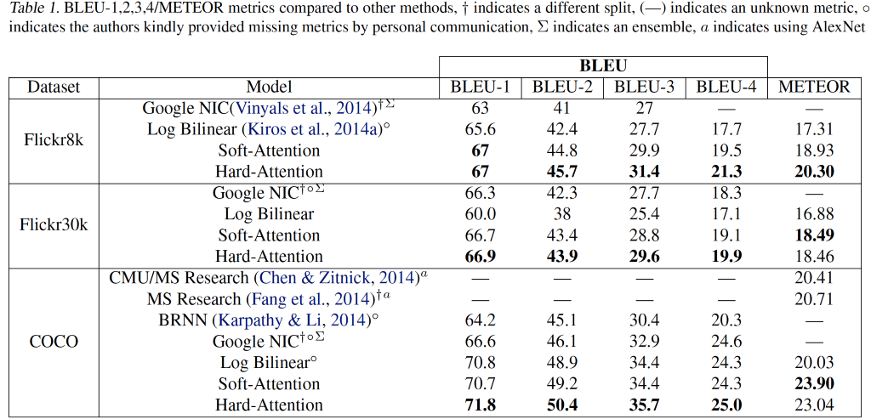
Quantitative Evaluation

Slide 26
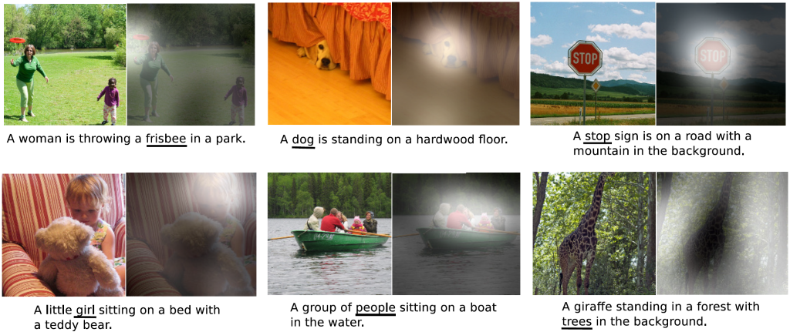
Qualitative Analysis - Visualization

Slide 27
Conclusion & Future of Image Captioning
Conclusion
“Attention” can help with the model interpretation
Alignments correspond well to human intuition
Future
Transformers
Can we replace CNNs and LSTMs with Transformers?

Slide 28
An Image is worth 16 x 16 words
Transformers for Image Recognition at Scale
Notes:
Now let’s do a deep dive into a Transfer Learning Algorithm: Spectral Feature Adaptation or SFA in short

Slide 29
Notes:
Finally, for us, this paper raises one very pertinent question:
- Can we combine Data-based interpretations and model-based interpretation to improve the performance of transfer learning?
- For example, Will combining data-based interpretations (like Spectral Feature Alignment) with model-based interpretations (like Deep Learning Sentiment Model) give better outcomes for the target domain?

Slide 30
Ed Questions
Notes:
Now we move on to Q&A. However we will first address the question asked on ed.

Slide 31
Dddd - Question
?

Slide 32
Taaa – Response
?

Slide 33
Questions Please!

Slide 34
Thanks!

